Slide 1
The Impact of Public Transit on Rideshare Demand in Austin, Texas
Jeffrey Finucane, Justin Heinzekehr, Jingya Ye, Ting Sit, Warren Ehrenfried

Slide 2
Overview of Project

Slide 3

Problem overview
Average U.S. “ridesharing” trip results in 69% more pollution than the transportation choices
Rideshare- 683 g CO2
Public Transit - 103g CO2
City of Austin to be opportunity to analyze ridesharing and public transit
Do rideshare services serve as a complement to public transportation or cannibalize public transit utilization?
What motivates a passenger to switch mode of transportation?
Notes:
Jeff

Slide 4
Problem Statement
Identify the potential complementary or substitution effects among public transit and rideshare usage in Austin to suggest strategies to convert rideshare rides to public transit rides in order to help meet the city’s 50/50 mode share target by 2039.
Key objectives:
Reduction in harmful emissions
More affordable and accessible transit services to citizens.
Less traffic congestion as rideshare rides decrease
Notes:
Jeff

Slide 5
Approach
Exploratory analysis on rideshare data, identify potential variables that explain rider’s behavior of using the service
Apply the same potential variables to bus ride data to assess if there are consistent compact to bus rider’s behavior of using public transit
Merge the two dataset to run linear regression bus ride against rideshare, controlling on the potential variables identified. Check model significance
Determine if complementary or substitution effect exists among rideshare and bus services
Apply high level CO2 emission reduction calculation and estimate social cost saving through benchmark from existing research
Notes:
Jeff

Slide 6
Overview of Data
Notes:
Jeff

Slide 7
Dataset Description
Austin Ride Volume - summarizes the total volume of rideshare on each day from June 16th,2016 to August 31st, 2016.
RideAustin_Weather - contains individual rideshares information such as start/end location coordinates, weather conditions, vehicle type
Fuel economy Vehicle - fuel consumption in both city and highway with CO2 emission on each specific vehicle.
CapMetro Shapefile - CapMetro detailed operation information which contains passenger volume at each station from June 2016 to January 2017
Census Dataset - The American Community Survey shows population density (ppsm) and median household income by census tract.
Notes:
Jeff

Slide 8
Cleaning Process
Remove rideshare trips that travelled >11km or last more than 120 minutes. Assumed those trips cannot be replaced by public transit.
Align time frame from Austin ride volume and CapMetro datasets; summarize the passenger volume from June to end of August,2016.
Rounded lat, long of bus volume dataset to 2 decimal places to group alongside rideshare volume

Slide 9
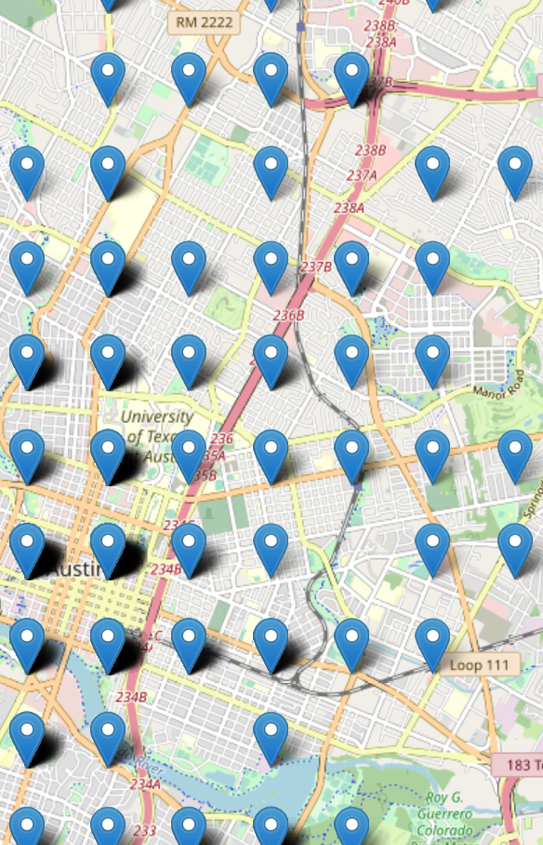
Estimating Walking Distance
Variable to determine if walking distance is a factor in choice of transportation
Calculate average distance from rideshare pick- up location to nearest bus stops
Straight-line euclidean distance method calculated for each data point to each bus stop location
Average distance of 3 nearest bus stops
Coarse coordinates: rideshare data only accurate to 2 decimal places or up to a km inaccurate (ex: Lat: 30.23, Long: -97.54)
Euclidean method imperfect for route distance
Rideshare coordinate precision is coarse

Slide 10
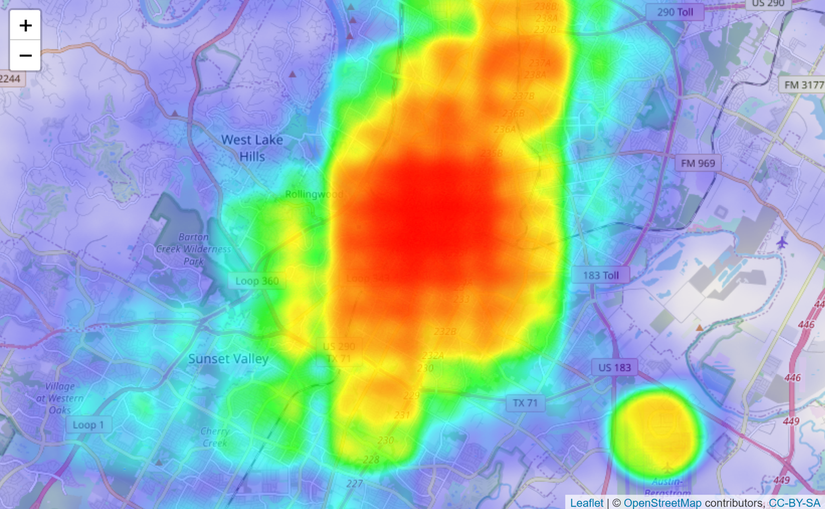
Spatial Binning of Coordinates
Spatial binning method applied to compiled rideshare/bus volume dataset for further analysis
Locations divided in a 5 x 5 grid resulting in 25 unique categorical variables
Grouped data regions providing more related and relevant data points
The result shows that bus volume has a negative relationship with rideshare volume and is somewhat significant with an R-squared value > 0.5
Heatmap showing density of rideshare pick-up locations

Slide 11
Initial Hypothesis
Control on day of week, hour of day, and weather condition, higher bus ride volume lead to lower rideshare volume (negatively correlated).
For the same to and from location, the longer the difference in traveled time among rideshare and public transposition, the higher the rideshare volume.
The shorter the distance between a pickup/dropoff location from a bus stop, the lower the share ride volume.
The fewer rides on the road through rideshare the less fuel consumed and less CO2 emissions (positive correlation).
Notes:
Jingya

Slide 12
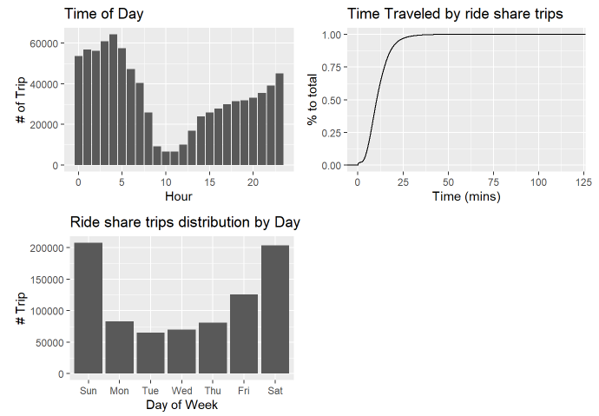
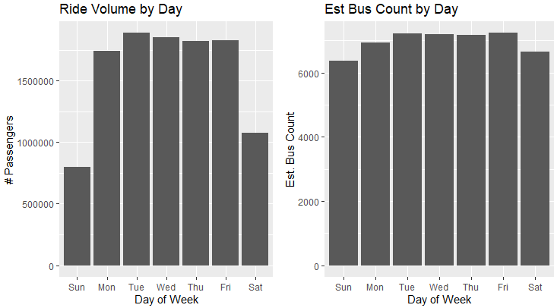
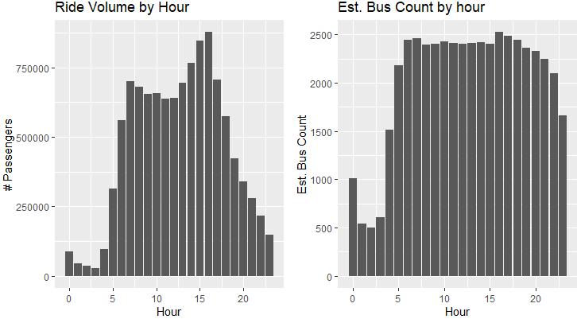
EDA
Bus rides Volume Pattern
Rideshares Volume Pattern
Observe inverse relationship among rideshare and bus ride volume, implies the possibility of substitution effect
Notes:
Jingya

Slide 13
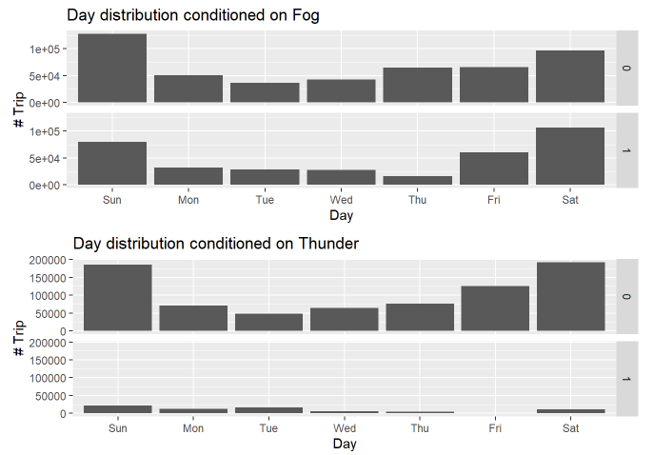
EDA (cont)
Rideshares Volume Pattern
Existence of weather conditions do not appear to affect rideshare usage distribution
Notes:
Jingya

Slide 14
Modeling

Slide 15
Key Variables
Rideshare volume (ride_vol) - Target
Bus ride volume (bus_vol)
Weekend/Weekday (wkd_end): Mon-Fri (weekday), Sat/Sun(weekend)
Hour of day (hr_cat): 4 categories (Midnight - 6am, 6am to 12noon, 12noon to 6pm, 6pm to midnight)
Weather conditions (Fog, Thunder)
Spatial binning (start_grid_cell)
Notes:
Ting

Slide 16
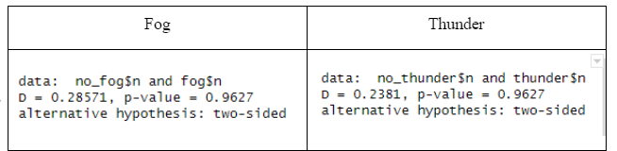
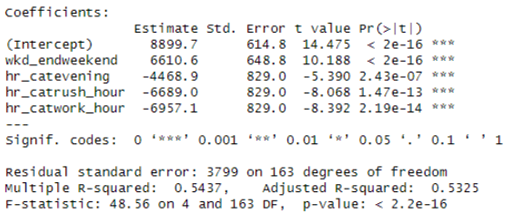
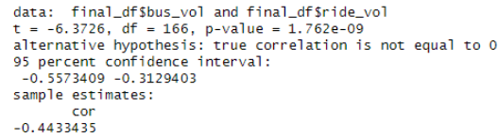
Statistical Tests
K-S Test on weather conditions
Not significant
Regression Test on hr_cat, wkd_end
Significant
Pearson Test on bus_vol
Significant
Notes:
Ting

Slide 17
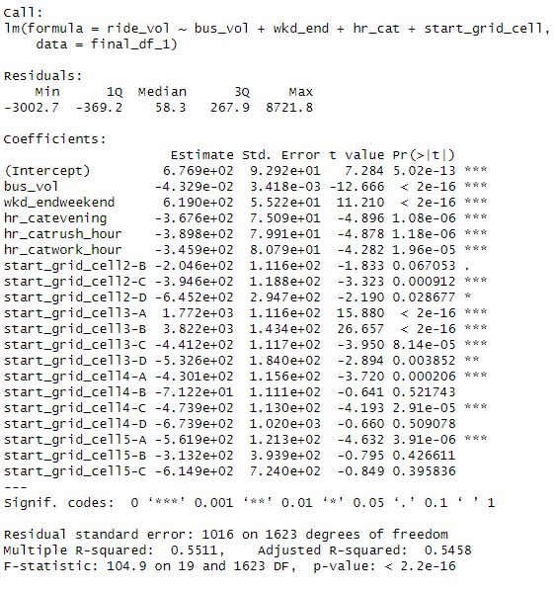
Linear Regression Model
Ride_vol ~ Bus_vol + wkd_end + hr_cat + start_grid_cell
Controlling on day of week, hour of day, and location factor, bus_vol is significant to predict ride_vol.
The effect is about -4%
R2 - 0.54
Notes:
Ting

Slide 18
Recommendation

Slide 19
Public Transit Expansion Opportunity
Can we add variables that allow us to predict public transportation use in areas without service?
2020 US Census: American Community Survey
Variables that significantly predict public transportation use:
Median household income
Population density (people per square mile)
Diversity of demand for rideshares: many times of day, days of week, and geographical locations within a given census tract
Notes:
Justin

Slide 20
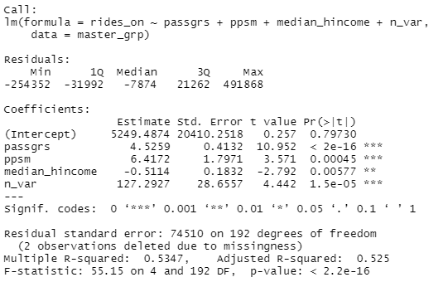
Public Transit Expansion Opportunity
Best potential locations for expanding public transportation are those with:
High demand for ridesharing (passgrs)
High population density (ppsm)
Low median income (median_hincome)
Use rideshares in variety of ways (n_var)
Notes:
Justin

Slide 21
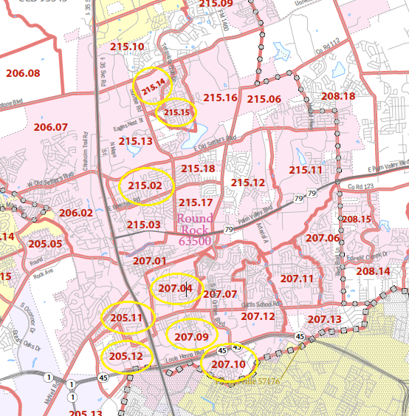
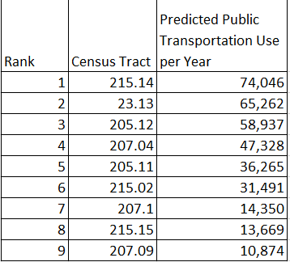
Public Transit Expansion Opportunity
Notes:
Justin

Slide 22
Predicted Business Outcomes
Recommendation: Add a route connecting these eight census tracts in the Round Rock neighborhood north of Austin.
Total new annual public transportation use: 286,958
Replaced rideshare use: 12,422
Estimated replaced private vehicle trips: ~150,000
Cost of constructing eight new bus stops: ~$280,000-$400,000
CO₂ emissions saved: ~98 tons per year, or $18,600 in terms of social value
Notes:
Justin

Slide 23

August 2017: CapMetro Expands into Round Rock
Notes:
Justin

Slide 24
Challenges
Imprecision of location data - distance variable couldn’t apply
Passenger’s behavior data - omitted from model due to time constraints on gathering the needed data
Austin population & economic growth impacts are ignored in the model
Rate of return on CO2 emission need more refinement to ensure that the recommendation is economically and socially attractive for the needed capital investment
Notes:
Jeff

Slide 25
Appendix

Slide 26
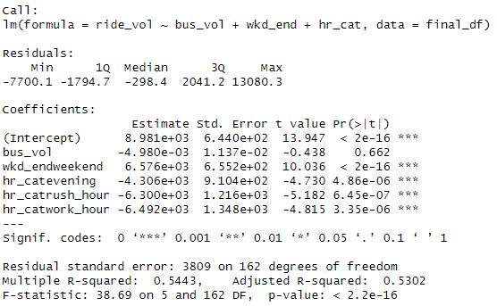
Linear Regression Model
Ride_vol ~ Bus_vol + wkd_end + hr_cat
Bus_vol, while shows negative coefficient as agreed with Pearson test, is not significant
Consider adding new variables to refine the model

Slide 27
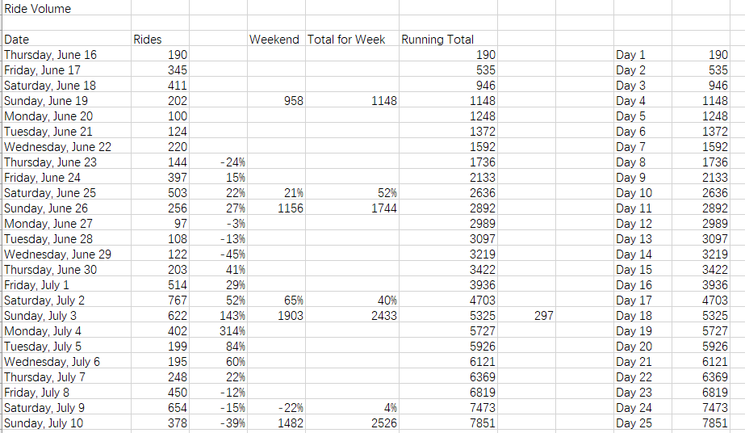
Austin Ride Volume
The data set summarizes the total volume of rideshare on each day from June 16th,2016 to August 31st, 2016. Number of rideshare will be the response to the model to be trained for.

Slide 28
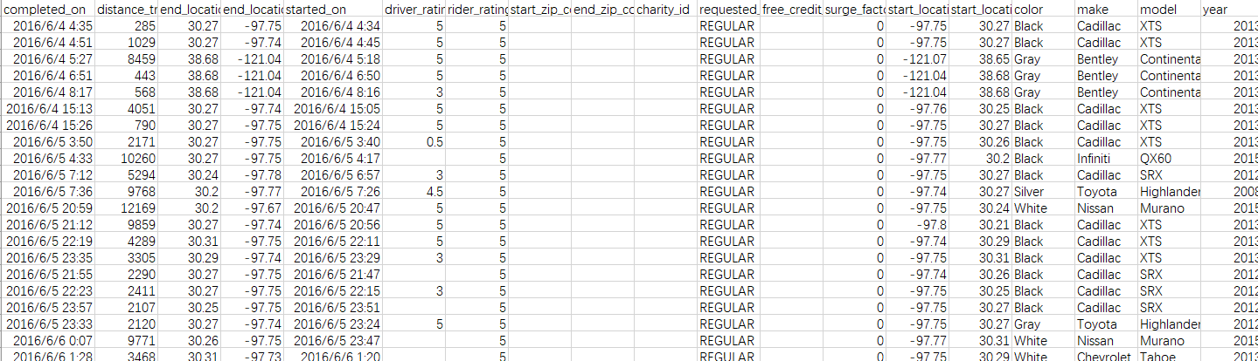
RideAustin_Weather
This data set contains key information which includes geographic start and end locations of the rideshare, detailed vehicle list and weather condition for each registered rideshare.

Slide 29
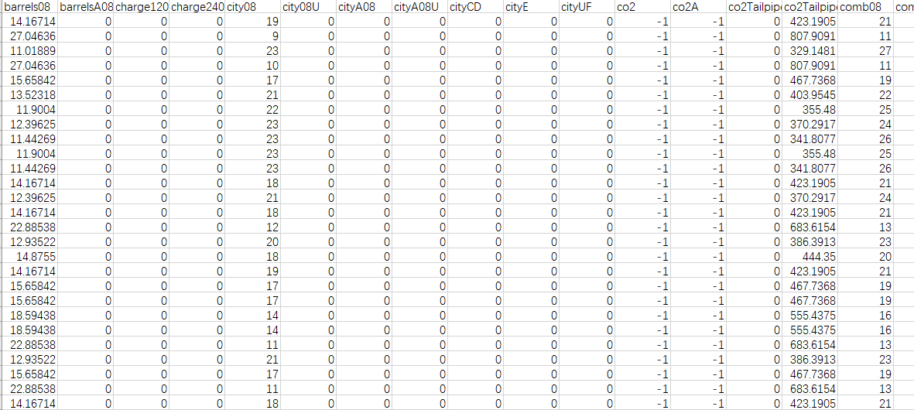
Fuel economy -Vehicle
This will help to get fuel consumption in both city and highway with CO2 emission on each specific vehicle.

Slide 30
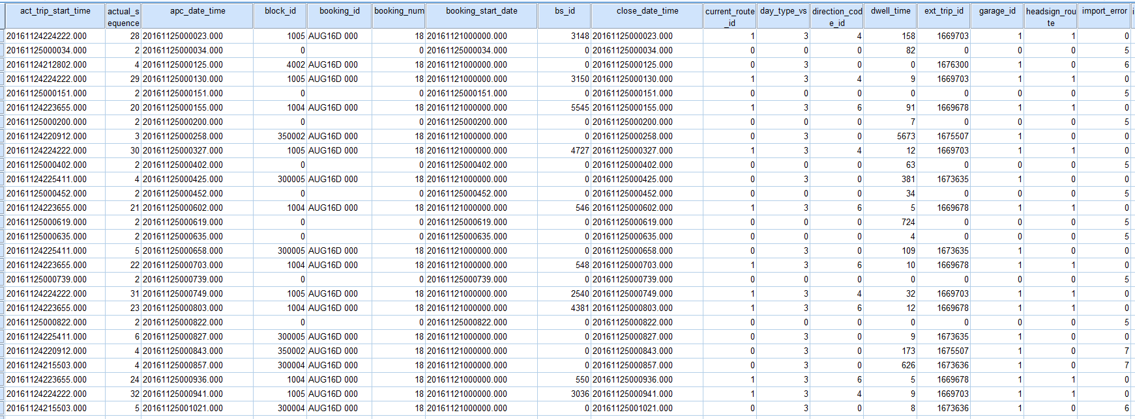
CapMetro Ridership Data
This data set contains the number of passengers getting on or off the CapMetro public transportation system by latitude and longitude from June 2016 to January 2017.

Slide 31
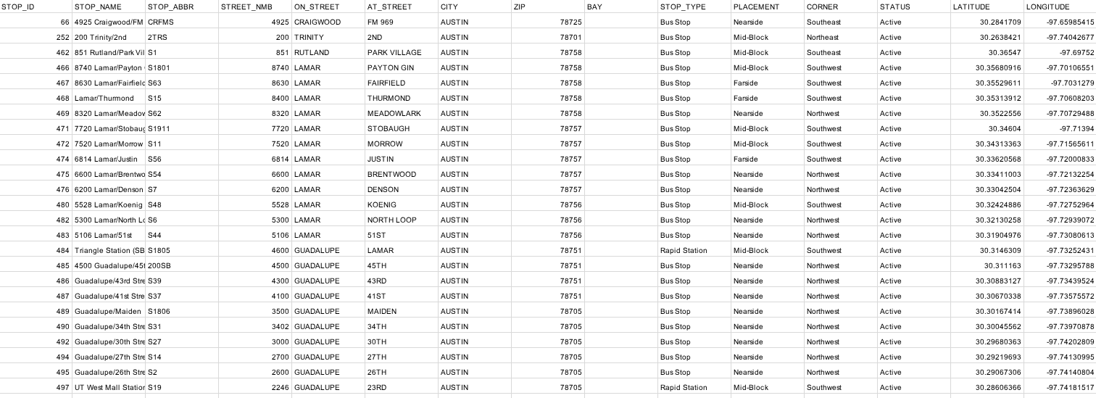
CapMetro Shapefile
Dataset contains the geographic locations of current public transit stops in the Austin CapMetro public transit city

Slide 32
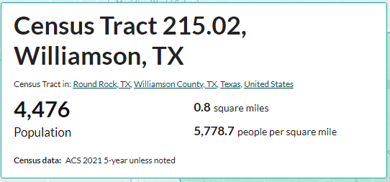
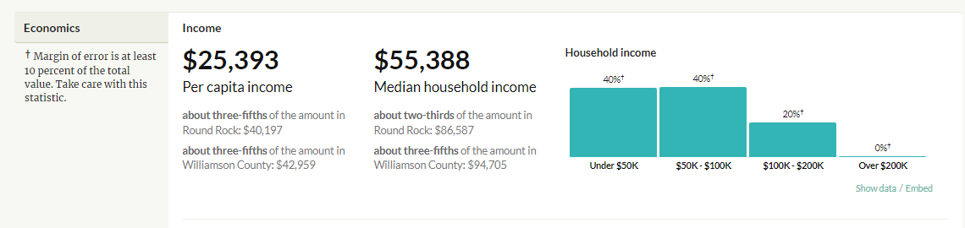
US Census Data
The ACS survey shows population density (ppsm) and median household income by census tract.
https://censusreporter.org

Slide 33
Reference
Anair, D., Martin, J., Pinto de Moura, M. C., & Goldman, J. (2020, February 25). Ride-Hailing Climate Risks | Union of Concerned Scientists. https://www.ucsusa.org/resources/ride-hailing-climate-risks(Anair et al., 2020)
Austin Motion. (2017). 2016 Mobility Bond program Overview And Implementation Plan [Capital Planning]. Austin City Government. https://www.austintexas.gov/sites/default/files/files/Capital_Planning/2016_Bond/FINAL_2016Bond_ProgramOverview_ImplementationUpdate_backup_reducedsize.pdf
CBS Austin. (2017). “Round Rock to get CapMetro bus service in August.” https://cbsaustin.com/news/local/round-rock-to-get-capmetro-bus-service-in-august
City of Austin Carbon Footprint (Number of Metric Tons of Carbon Dioxide Emissions from Our Government Activity).” Data.Austintexas.Gov, Sept. 2021,
data.austintexas.gov/stories/s/HE-E-3-City-of-Austin-carbon-footprint-number-of-m/k8ja-qxaz/.
Erhardt, G. D., Hoque, J. M., Goyal, V., Berrebi, S., Brakewood, C., & Watkins, K. E. (2022). Why has public transit ridership declined in the United States? Transportation Research Part A: Policy and Practice, 161, 68–87. https://doi.org/10.1016/j.tra.2022.04.006
Go Durham. (2023, March 16). Story Map Shortlist. https://triangletransit.maps.arcgis.com/apps/Shortlist/index.html?appid=5c5787e5a105433c904bd45fcb422332
Hersher, R., Ramirez, R., Scott, A., & Cirino, M. (2023, February 9). EPA’s proposal to raise the cost of carbon is a powerful tool and ethics nightmare. NPR. https://www.npr.org/2023/02/08/1155544378/epas-proposal-to-raise-the-cost-of-carbon-is-a-powerful-tool-and-ethics-nightmar
Hoffmann Pham, K., Ipeirotis, P. G., & Sundararajan, A. (2019). Ridesharing and the Use of Public Transportation. SSRN Electronic Journal. https://doi.org/10.2139/ssrn.4099122
Pan, Y., & Qiu, L. (2022). How Ride-Sharing Is Shaping Public Transit System: A Counterfactual Estimator Approach. Production And Operations Management, 31(2), 906–927. https://doi.org/10.1111/poms.13582
Zhang, Y., & Zhang, Y. (2018). Exploring the Relationship between Ridesharing and Public Transit Use in the United States. International Journal of Environmental Research and Public Health, 15(8), 1763. https://doi.org/10.3390/ijerph15081763

